Slide 1

SnapSat
Preliminary Design Solution
Notes:
Good Morning etc.

Slide 2
Meet the Team
James Allworth – Attitude Determination and Control
Thomas Forbutt – Communications and On-board Data Handling
Oscar McNulty – Structural Design and Development
Penelope Player – On-board Computer and Power System
Nikita Sardesai – Thermal Control and Payload
Notes:
First lets start by introducing the team. If you have any questions, feel free to ask.

Slide 3
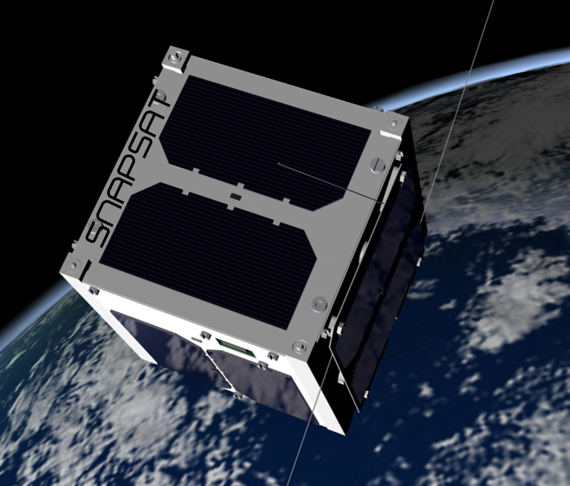
Our Mission
PRIMARY
To bring space to YOU
Notes:
So what’s out mission? SnapSat is destined to be a satellite that is directly accessible to you!
SnapSat is a nano-satellite designed for outreach and space accessibility for educational bodies and the general public. In a sun-synchronous orbit at an altitude of 350km, SnapSat will be in the prime position of Earth observation. Users can send a message to the cubesat, which will take beautiful images of the Earth and tweet it to the world.
SnapSat will relay position data, so users are able to take photographs where they please. There is also scope for the development of a desktop/phone application for direct user connection to the satellite via groundstation.
Following the success the final build and launch, the team is hoping to lunch SnapSat on a sounding rocket - where it will stay in a LEO for about 3 months, taking beautiful photographs!

Slide 4
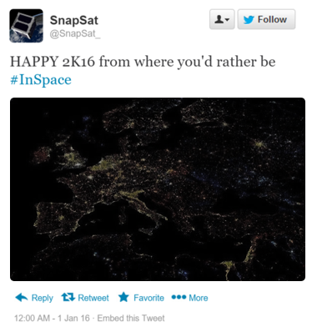
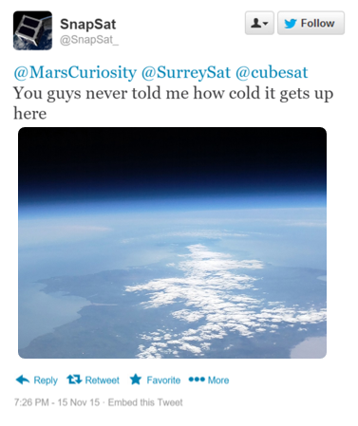
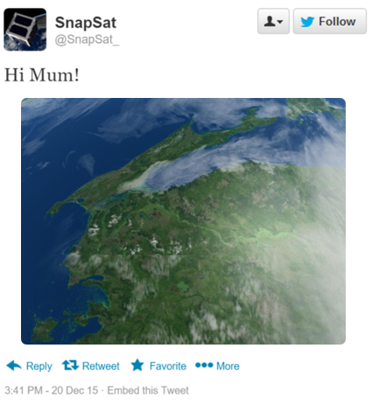
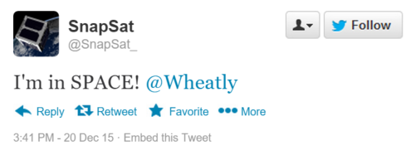
Potential
Heaps of outreach and advertising potential
Notes:
For example (These are hypothetical and not images taken with SnapSat. However, these are indicative of the quality of photos we are hoping to achieve):

Slide 5
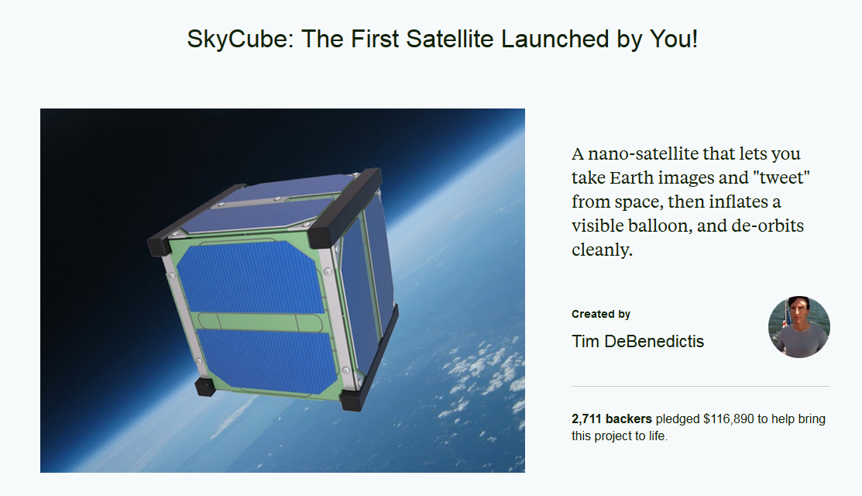
Our Mission
SECONDARY
To demonstrate that a functional CubeSat can be built on a low budget
Notes:
Secondary objective is to demonstrate that a functional CubeSat can be built on a low budget.
Current cubesats eg. Skycube cost $100000 dollars – and even then sometimes they don’t work. In their review they said that if they did it again they would concentre on the simple things – well yes, we would too if we had this much money behind it – but we don’t which gives us flexibility to mess up.
Solve problem of high end satellites, using low end ones.
To this end we are focusing on what is hard to to cheaply in space.
Generate enough power
Transmit enough data back

Slide 6
CubeSat Limitations
Common Problems
Power Limitations
Size Limitations
Transmission Power Problems
Innovative Subsections
Increase transmission power
Increase power generation
Notes:
TOM PLEASE WRITE HERE WHY THERE IS NORMALLY NOT ENOUGH TRANSMISSION POWER
First innovation is in the structure

Slide 7
Structural Design

Slide 8
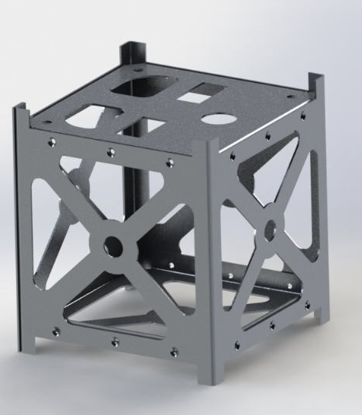
Design Considerations
(include picture of deployed solar panels also?)
OSCAR?
Notes:
Option 2 is 3D printing, will be more accessible to people in future

Slide 9
Simulation

Slide 10
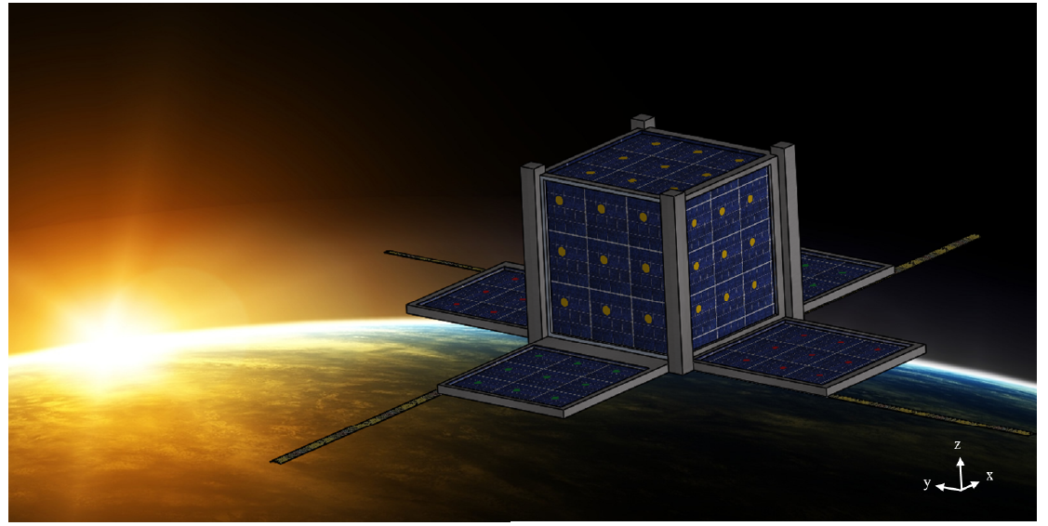
Deployable Solar Panels
Inspirations
SkyCube - Kickstarter
FlowerSat – STEMN
Only if we 3D print structure

Slide 11
System Budgets
Power, Data and Mass Considerations

Slide 12
Mass Budget
Subsystem | Component | Mass + Contingency | Fraction of total mass
Structural | Chassis – Laser cut Aluminium Solar Panels – Australian Robotics | 435 g | 47.6%
ADCS | Air core coils (in house) Osram photodiodes Adafruit 9DOF IMU | 180.2 g | 22%
EPS | Batteries & Power bus | 122 g | 14.9%
OBC / OBDH | Arduino DUE board Memory storage | 31.2 g | 3.8%
TT&C | Antennae VHF/UHF receivers/transmitters | 84 g | 10.3%
Thermal | Heat taping, Kapton tape Multi-layer insulation | 4.8 g | 0.6%
Payload | Arducam | 25 g | 3.1%
Integration | Wires, bolts and cables | 9.5 g | 1.2%
Notes:
Go though component selection
Note: we were able to achieve such a high mass budget since expesive, space rated and optimised componenet were selected.

Slide 13
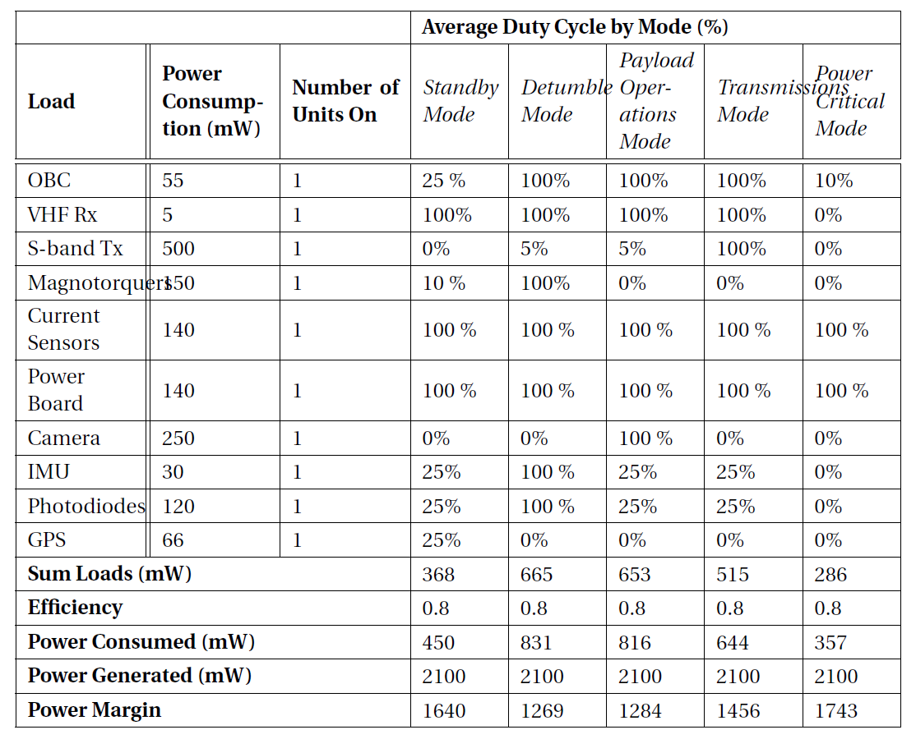
Power Budget
Notes:
Most power is reserved for transmissions
Priority one is a working cube sat, then the quality of the payload

Slide 14
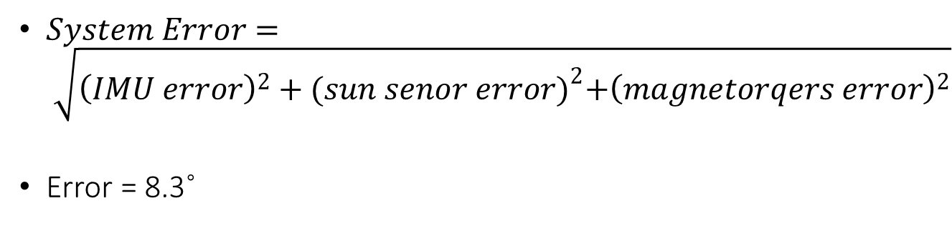
Pointing Budget
$System Error= \sqrt{{\left(IMU error\right)}^{2}+{(sun senor error)}^{2}+{\left(magnetorqers error\right)}^{2}}$
Error = 8.3˚
 | IMU Error (%) | Solar Tracker Error (%) | Magnetorquer Error (%) | Total Error (%) | Total Error (degrees)
Overall System | 2.0 | 0.5 | 1.0 | 2.3 | 8.3
System 1 | 2.0 |  | 1.0 | 2.2 | 7.9
System 2 |  | 1.0 | 1.0 | 1.1 | 4.0
Notes:
Since this spacecraft is performing Earth observation, it requires a pointing budget. This refers to the ability to orient the spacecraft towards a target having a specific geographical orientation. Along with the pointing accuracy, the satellite needs to be able to map the location from its own location. Errors in both pointing and mapping accuracies will be discussed here.
The attitude control system for SnapSat will consist of three air core magnetorquers operating on 3 separate planes capable of producing 0.05Am2 each. Only two of the magnetorquers can work at any one time, which will reduce total power usage for the system. The first component of the determination system is a 9-DOF IMU which will primarily be used in the de-tumble phase due to accumulated error issues with this equipment which are expected to occur later in the mission. The second component is a solar tracker system consisting of six photodiode pins, one on each face, which will be used to accurately determine the attitude of the satellite based on the location of the Sun.
According to the specification data, the IMU will experience a 2\% error based on the expected temperature range, although this will increase over the course of the mission due to the accumulated error. Although the exact error will need to be calculated during calibration and testing, based on current literature there are a number of similar solar tracking systems which are able to achieve an accuracy of 0.2\% \cite{beaudette}. However given the low budget and subsequently slightly inferior equipment conservative estimate of 0.5\% will be used for the solar tracker error. In regards to the magnetorquers expected error based on similar models 1\%, although error will be finalised during the calibration and testing phase.

Slide 15
Link and Data Budgets
TOM

Slide 16
Transmission Innovation
TOM

Slide 17
Operation Overview
Component Selection and Operation

Slide 18
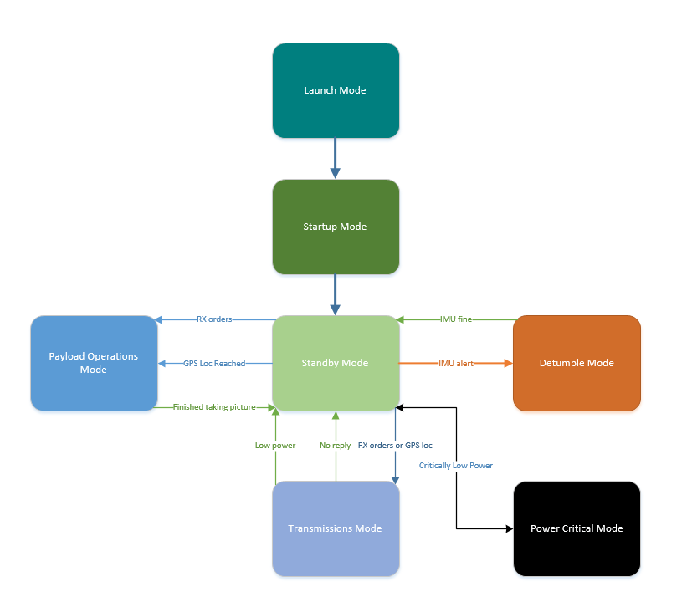
Modes of Operation

Slide 19
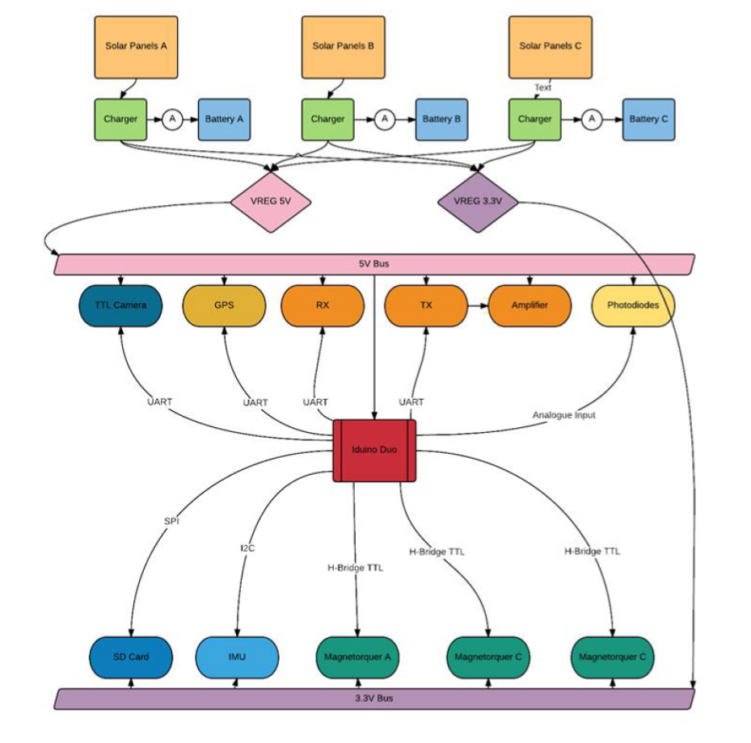
Design Schematic

Slide 20
SnapSat
Preliminary Design Solution
stemn.com/projects/cubesat-alpha

